Slide 1
Introduction to Artificial Intelligence
CT017-3-1 Ver 1.0
Overview

Slide 2
Lecturer information
Lecturer Name: Vinothini – Dr Vino / Ms Vino
Email: vinothini@apu.edu.my
Location : FCET (5 floor)

Slide 3
Pre-requisites for this module
NILL

Slide 4
Aims of this module
This module will enable the students to acquire a basic understanding of current key Artificial Intelligence (AI) concepts.
Areas to be covered will include Types of Knowledge Representation, Searching Methods, PROLOG, Areas of AI.
The student will be expected to demonstrate a basic proficiency in AI Problem-solving

Slide 5
Learning outcomes
At the end of this module, YOU should be able to:
Describe the fundamental AI concepts, principles and methods (C2,PL01)
Implement a range of AI techniques and apply a specific AI methods to problem solving (C3,PL03)
Demonstrate domain knowledge in terms of production rules, semantic network, frames and the strength and weakness (A3,PL07)

Slide 6
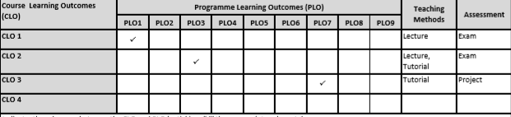
Mapping of CLOs with MOEs Domain
PLO1 – Knowledge
PLO3 – Problem Solving and Scientific Skills
PLO6 – Values, Attitude and Professionalism

Slide 7
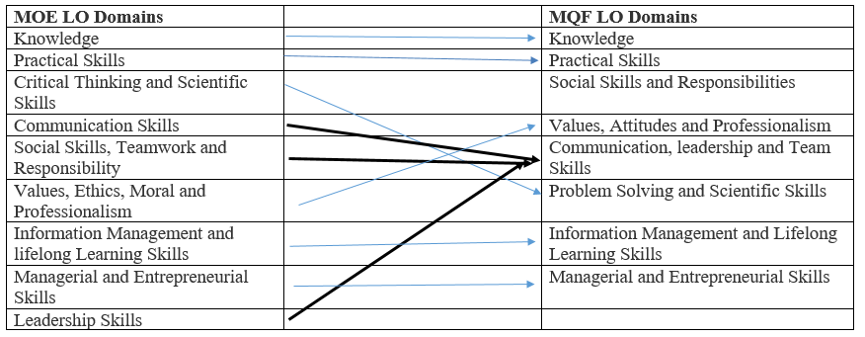
MQF and MOE Domains

Slide 8
Student Learning Time (SLT)
Module Credit Value:
Total Learning Hours:
Lecture: 24 hours Tutorial: 18 hours Independent Learning: 64 hours

Slide 9
Methods of Delivery
Hence,
We are now moving from the traditional topic based teaching to outcome-based education

Slide 10
Outcomes Based Education (OBE)
OBE is education based on producing particular educational outcomes that:
Focus on what students can actually do after they are taught
Expect all learners / students to successfully achieve particular (sometimes minimum) level of knowledge and abilities.

Slide 11
So…What is OBE?
It’s
NOT
What we want to teach,
It’s
What You should learn

Slide 12
Topics we will cover
Introduction
Basic Concepts of AI
Introduction to Expert Systems
Expert Systems
Knowledge Representation 1
Knowledge Representation 2
Introduction to Uninformed Search
Introduction to Informed Search
Informed Search
A* search
Intro to Prolog
Prolog
Rete Algorithm
Automated Systems

Slide 13
What is expected of you
What is expected of you
You should abide to all the rules & regulation of APU
Proper attire
No speaking of dialects
Attendance is compulsory and valid medical certificates or letters from parents /guardians must support any absence from class.
Three lateness will be equal to one absence
All pagers and handphones should be turned off during lectures.

Slide 14
What support is available for you
Consultation hours
Resources
Reference material
Russell, S. J., Norvig, P. (2016). Artificial intelligence: a modern approach. 3rd ed. Pearson Education Limited. ISBN-13: 978-0136042594
Ertel,W. (2018). Introduction to artificial intelligence(Undergraduate Topics in Computer Science). 2nd ed. Springer ,ISBN-13: 978-3319584867
Poole, D. L. & Mackworth, A. K. (2017). Artificial Intelligence: foundations of computational agents. 2nd ed. Cambridge University Press. ISBN-13: 978-1107195394
*Note : Older references are indispensable and have no substitute as Q1 2018

Slide 15
How you will be assessed
Incourse Assessment 100%
Group assignment 50%
Hand out Hand in Return
Week 2 Week 15 Week 16
3 in a group or 2 in a group
Alternative Exam – multiple choice – 35 question & 25 marks sturtuture in 1 hour

Slide 16
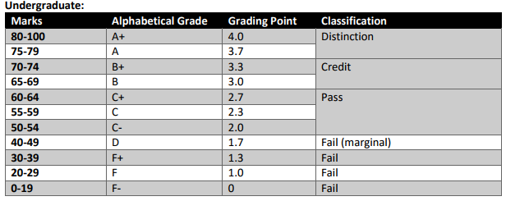
Achievement requirements

Slide 17
Question and answer session
Q & A

Slide 18
What we will cover next
Introduction to Artificial Intelligence

